Slide 1
Data Mining:
Concepts and Techniques
(3rd ed.)
— Chapter 8 —
Jiawei Han, Micheline Kamber, and Jian Pei
University of Illinois at Urbana-Champaign &
Simon Fraser University
©2011 Han, Kamber & Pei. All rights reserved.

Slide 2
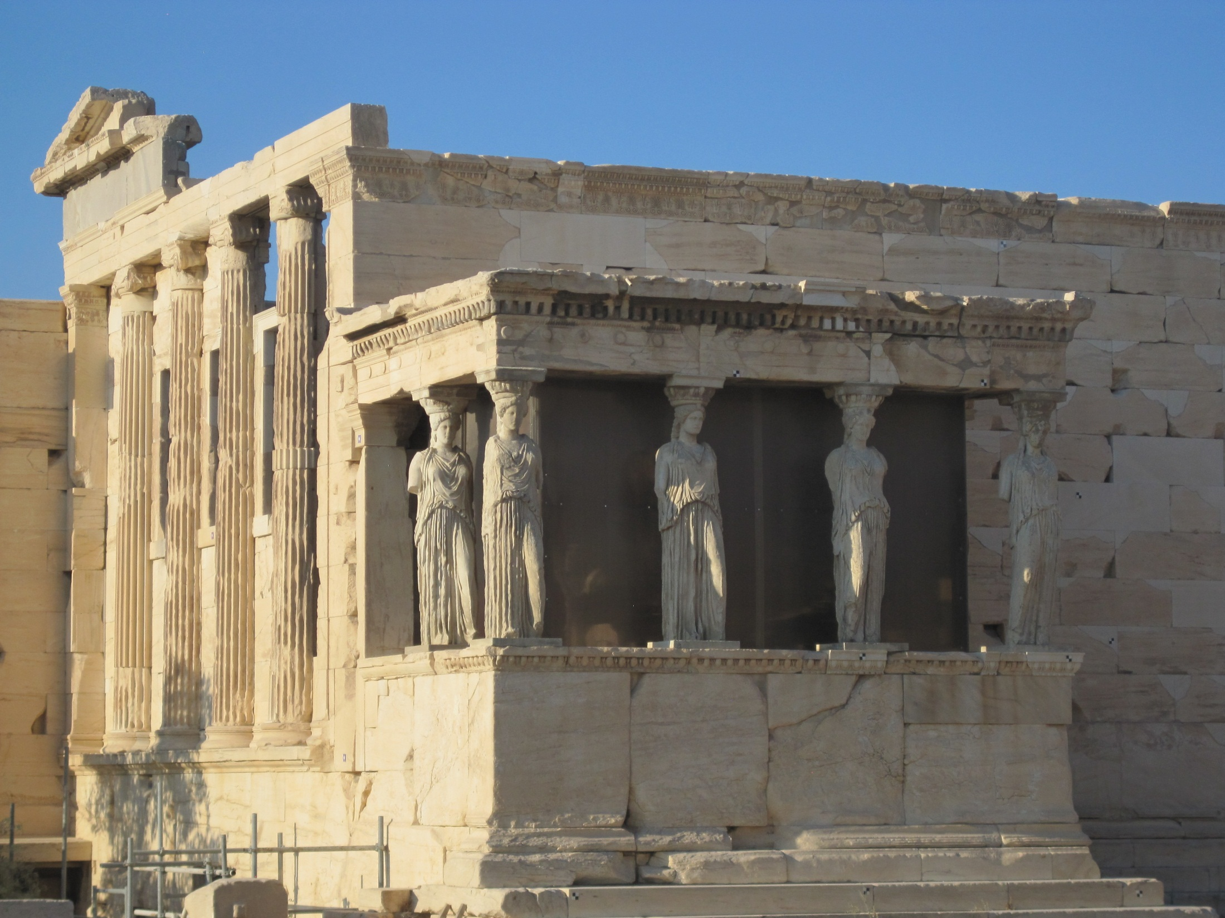

Slide 3
Chapter 8. Classification: Basic Concepts
Classification: Basic Concepts
Decision Tree Induction
Bayes Classification Methods
Rule-Based Classification
Model Evaluation and Selection
Techniques to Improve Classification Accuracy: Ensemble Methods
Summary

Slide 4
Supervised vs. Unsupervised Learning
Supervised learning (classification)
  Supervision: The training data (observations, measurements, etc.) are accompanied by labels indicating the class of the observations
  New data is classified based on the training set
Unsupervised learning (clustering)
  The class labels of training data is unknown
  Given a set of measurements, observations, etc. with the aim of establishing the existence of classes or clusters in the data

Slide 5
Prediction Problems: Classification vs. Numeric Prediction
Classification
  predicts categorical class labels (discrete or nominal)
  classifies data (constructs a model) based on the training set and the values (class labels) in a classifying attribute and uses it in classifying new data
Numeric Prediction
  models continuous-valued functions, i.e., predicts unknown or missing values
Typical applications
  Credit/loan approval:
  Medical diagnosis: if a tumor is cancerous or benign
  Fraud detection: if a transaction is fraudulent
  Web page categorization: which category it is

Slide 6
Classification—A Two-Step Process
Model construction: describing a set of predetermined classes
  Each tuple/sample is assumed to belong to a predefined class, as determined by the class label attribute
  The set of tuples used for model construction is training set
  The model is represented as classification rules, decision trees, or mathematical formulae
Model usage: for classifying future or unknown objects
  Estimate accuracy of the model
    The known label of test sample is compared with the classified result from the model
    Accuracy rate is the percentage of test set samples that are correctly classified by the model
    Test set is independent of training set (otherwise overfitting)
  If the accuracy is acceptable, use the model to classify new data
Note: If the test set is used to select models, it is called validation (test) set

Slide 7



Process (1): Model Construction
Classification
Algorithms
Training
Data
Classifier
(Model)
IF rank = ‘professor’
OR years > 6
THEN tenured = ‘yes’

Slide 8




Process (2): Using the Model in Prediction
Classifier
Testing
Data
Unseen Data
(Jeff, Professor, 4)
Tenured?

Slide 9
Chapter 8. Classification: Basic Concepts
Classification: Basic Concepts
Decision Tree Induction
Bayes Classification Methods
Rule-Based Classification
Model Evaluation and Selection
Techniques to Improve Classification Accuracy: Ensemble Methods
Summary

Slide 10

Decision Tree Induction: An Example
Training data set: Buys_computer
The data set follows an example of Quinlan’s ID3 (Playing Tennis)
Resulting tree:
age?
<=30
overcast
>40
31..40
student?
yes
credit rating?
no
yes
excellent
fair
no
yes
no
yes

Slide 11
Algorithm for Decision Tree Induction
Basic algorithm (a greedy algorithm)
  Tree is constructed in a top-down recursive divide-and-conquer manner
  At start, all the training examples are at the root
  Attributes are categorical (if continuous-valued, they are discretized in advance)
  Examples are partitioned recursively based on selected attributes
  Test attributes are selected on the basis of a heuristic or statistical measure (e.g., information gain)
Conditions for stopping partitioning
  All samples for a given node belong to the same class
  There are no remaining attributes for further partitioning – majority voting is employed for classifying the leaf
  There are no samples left

Slide 12


Brief Review of Entropy
m = 2

Slide 13



Attribute Selection Measure: Information Gain (ID3/C4.5)
Select the attribute with the highest information gain
Let p_{i} be the probability that an arbitrary tuple in D belongs to class C_{i}, estimated by |C_{i, D}|/|D|
Expected information (entropy) needed to classify a tuple in D:
Information needed (after using A to split D into v partitions) to classify D:
Information gained by branching on attribute A
Notes:
I : the expected information needed to classify a given sample
E (entropy) : expected information based on the partitioning into subsets by A

Slide 14






Attribute Selection: Information Gain
Class P: buys_computer = “yes”
Class N: buys_computer = “no”
means “age <=30” has 5 out of 14 samples, with 2 yes’es and 3 no’s. Hence
Similarly,

Slide 15
Computing Information-Gain for Continuous-Valued Attributes
Let attribute A be a continuous-valued attribute
Must determine the best split point for A
  Sort the value A in increasing order
  Typically, the midpoint between each pair of adjacent values is considered as a possible split point
    (a_{i}+a_{i+1})/2 is the midpoint between the values of a_{i} and a_{i+1}
  The point with the minimum expected information requirement for A is selected as the split-point for A
Split:
  D1 is the set of tuples in D satisfying A ≤ split-point, and D2 is the set of tuples in D satisfying A > split-point

Slide 16

Gain Ratio for Attribute Selection (C4.5)
Information gain measure is biased towards attributes with a large number of values
C4.5 (a successor of ID3) uses gain ratio to overcome the problem (normalization to information gain)
  GainRatio(A) = Gain(A)/SplitInfo(A)
Ex.
  gain_ratio(income) = 0.029/1.557 = 0.019
The attribute with the maximum gain ratio is selected as the splitting attribute

Slide 17



Gini Index (CART, IBM IntelligentMiner)
If a data set D contains examples from n classes, gini index, gini(D) is defined as
where p_{j} is the relative frequency of class j in D
If a data set D is split on A into two subsets D₁ and D₂, the gini index gini(D) is defined as
Reduction in Impurity:
The attribute provides the smallest gini_{split}(D) (or the largest reduction in impurity) is chosen to split the node (need to enumerate all the possible splitting points for each attribute)

Slide 18



Computation of Gini Index
Ex. D has 9 tuples in buys_computer = “yes” and 5 in “no”
Suppose the attribute income partitions D into 10 in D₁: {low, medium} and 4 in D₂
  Gini_{{low,high}} is 0.458; Gini_{{medium,high}} is 0.450. Thus, split on the {low,medium} (and {high}) since it has the lowest Gini index
All attributes are assumed continuous-valued
May need other tools, e.g., clustering, to get the possible split values
Can be modified for categorical attributes

Slide 19
Comparing Attribute Selection Measures
The three measures, in general, return good results but
  Information gain:
    biased towards multivalued attributes
  Gain ratio:
    tends to prefer unbalanced splits in which one partition is much smaller than the others
  Gini index:
    biased to multivalued attributes
    has difficulty when # of classes is large
    tends to favor tests that result in equal-sized partitions and purity in both partitions

Slide 20
Other Attribute Selection Measures
CHAID: a popular decision tree algorithm, measure based on χ² test for independence
C-SEP: performs better than info. gain and gini index in certain cases
G-statistic: has a close approximation to χ² distribution
MDL (Minimal Description Length) principle (i.e., the simplest solution is preferred):
  The best tree as the one that requires the fewest # of bits to both (1) encode the tree, and (2) encode the exceptions to the tree
Multivariate splits (partition based on multiple variable combinations)
  CART: finds multivariate splits based on a linear comb. of attrs.
Which attribute selection measure is the best?
  Most give good results, none is significantly superior than others

Slide 21
Overfitting and Tree Pruning
Overfitting: An induced tree may overfit the training data
  Too many branches, some may reflect anomalies due to noise or outliers
  Poor accuracy for unseen samples
Two approaches to avoid overfitting
  Prepruning: Halt tree construction early ̵ do not split a node if this would result in the goodness measure falling below a threshold
    Difficult to choose an appropriate threshold
  Postpruning: Remove branches from a “fully grown” tree—get a sequence of progressively pruned trees
    Use a set of data different from the training data to decide which is the “best pruned tree”

Slide 22
Enhancements to Basic Decision Tree Induction
Allow for continuous-valued attributes
  Dynamically define new discrete-valued attributes that partition the continuous attribute value into a discrete set of intervals
Handle missing attribute values
  Assign the most common value of the attribute
  Assign probability to each of the possible values
Attribute construction
  Create new attributes based on existing ones that are sparsely represented
  This reduces fragmentation, repetition, and replication

Slide 23
Chapter 8. Classification: Basic Concepts
Classification: Basic Concepts
Decision Tree Induction
Bayes Classification Methods
Rule-Based Classification
Model Evaluation and Selection
Techniques to Improve Classification Accuracy: Ensemble Methods
Summary

Slide 24
Model Evaluation and Selection
Evaluation metrics: How can we measure accuracy? Other metrics to consider?
Use validation test set of class-labeled tuples instead of training set when assessing accuracy
Methods for estimating a classifier’s accuracy:
  Holdout method, random subsampling
  Cross-validation
  Bootstrap
Comparing classifiers:
  Confidence intervals
  Cost-benefit analysis and ROC Curves

Slide 25
Classifier Evaluation Metrics: Confusion Matrix
Confusion Matrix:
Actual class\Predicted class | C₁ | ¬ C₁
C₁ | True Positives (TP) | False Negatives (FN)
¬ C₁ | False Positives (FP) | True Negatives (TN)
Example of Confusion Matrix:
Actual class\Predicted class | buy_computer = yes | buy_computer = no | Total
buy_computer = yes | 6954 | 46 | 7000
buy_computer = no | 412 | 2588 | 3000
Total | 7366 | 2634 | 10000
Given m classes, an entry, CM_{i,j} in a confusion matrix indicates # of tuples in class i that were labeled by the classifier as class j
May have extra rows/columns to provide totals

Slide 26
Classifier Evaluation Metrics: Accuracy, Error Rate, Sensitivity and Specificity
A\P | C | ¬C
C | TP | FN | P
¬C | FP | TN | N
 | P’ | N’ | All
Class Imbalance Problem:
  One class may be rare, e.g. fraud, or HIV-positive
  Significant majority of the negative class and minority of the positive class
  Sensitivity: True Positive recognition rate
    Sensitivity = TP/P
  Specificity: True Negative recognition rate
    Specificity = TN/N
Classifier Accuracy, or recognition rate: percentage of test set tuples that are correctly classified
  Accuracy = (TP + TN)/All
Error rate: 1 – accuracy, or
  Error rate = (FP + FN)/All

Slide 27




Classifier Evaluation Metrics:
Precision and Recall, and F-measures
Precision: exactness – what % of tuples that the classifier labeled as positive are actually positive
Recall: completeness – what % of positive tuples did the classifier label as positive?
Perfect score is 1.0
Inverse relationship between precision & recall
F measure (F₁ or F-score): harmonic mean of precision and recall,
F_{ß}: weighted measure of precision and recall
  assigns ß times as much weight to recall as to precision

Slide 28
Classifier Evaluation Metrics: Example
Actual Class\Predicted class | cancer = yes | cancer = no | Total | Recognition(%)
cancer = yes | 90 | 210 | 300 | 30.00 (sensitivity
cancer = no | 140 | 9560 | 9700 | 98.56 (specificity)
Total | 230 | 9770 | 10000 | 96.40 (accuracy)
  Precision = 90/230 = 39.13% Recall = 90/300 = 30.00%

Slide 29
Evaluating Classifier Accuracy:
Holdout & Cross-Validation Methods
Holdout method
  Given data is randomly partitioned into two independent sets
    Training set (e.g., 2/3) for model construction
    Test set (e.g., 1/3) for accuracy estimation
  Random sampling: a variation of holdout
    Repeat holdout k times, accuracy = avg. of the accuracies obtained
Cross-validation (k-fold, where k = 10 is most popular)
  Randomly partition the data into k mutually exclusive subsets, each approximately equal size
  At i-th iteration, use D_{i} as test set and others as training set
  Leave-one-out: k folds where k = # of tuples, for small sized data
  *Stratified cross-validation*: folds are stratified so that class dist. in each fold is approx. the same as that in the initial data

Slide 30

Evaluating Classifier Accuracy: Bootstrap
Bootstrap
  Works well with small data sets
  Samples the given training tuples uniformly with replacement
    i.e., each time a tuple is selected, it is equally likely to be selected again and re-added to the training set
Several bootstrap methods, and a common one is .632 boostrap
  A data set with d tuples is sampled d times, with replacement, resulting in a training set of d samples. The data tuples that did not make it into the training set end up forming the test set. About 63.2% of the original data end up in the bootstrap, and the remaining 36.8% form the test set (since (1 – 1/d)^{d} ≈ e⁻¹ = 0.368)
  Repeat the sampling procedure k times, overall accuracy of the model:

Slide 31


Estimating Confidence Intervals:
Classifier Models M₁ vs. M₂
Suppose we have 2 classifiers, M₁ and M₂, which one is better?
Use 10-fold cross-validation to obtain and
These mean error rates are just estimates of error on the true population of future data cases
What if the difference between the 2 error rates is just attributed to chance?
  Use a test of statistical significance
  Obtain confidence limits for our error estimates

Slide 32
Estimating Confidence Intervals:
Null Hypothesis
Perform 10-fold cross-validation
Assume samples follow a t distribution with k–1 degrees of freedom (here, k=10)
Use t-test (or Student’s t-test)
Null Hypothesis: M₁ & M₂ are the same
If we can reject null hypothesis, then
  we conclude that the difference between M₁ & M₂ is statistically significant
  Chose model with lower error rate

Slide 33


Estimating Confidence Intervals: t-test
If only 1 test set available: pairwise comparison
  For i^{th} round of 10-fold cross-validation, the same cross partitioning is used to obtain err(M₁)_{i} and err(M₂)_{i}
  Average over 10 rounds to get
  t-test computes t-statistic with k-1 degrees of freedom:
If two test sets available: use non-paired t-test
and
where
where
where k₁ & k₂ are # of cross-validation samples used for M₁ & M₂, resp.

Slide 34


Estimating Confidence Intervals:
Table for t-distribution
Symmetric
Significance level, e.g., sig = 0.05 or 5% means M₁ & M₂ are significantly different for 95% of population
Confidence limit, z = sig/2

Slide 35
Estimating Confidence Intervals:
Statistical Significance
Are M₁ & M₂ significantly different?
  Compute t. Select significance level (e.g. sig = 5%)
  Consult table for t-distribution: Find t value corresponding to k-1 degrees of freedom (here, 9)
  t-distribution is symmetric: typically upper % points of distribution shown → look up value for confidence limit z=sig/2 (here, 0.025)
  If t > z or t < -z, then t value lies in rejection region:
    Reject null hypothesis that mean error rates of M₁ & M₂ are same
    Conclude: statistically significant difference between M₁ & M₂
  Otherwise, conclude that any difference is chance

Slide 36

Model Selection: ROC Curves
ROC (Receiver Operating Characteristics) curves: for visual comparison of classification models
Originated from signal detection theory
Shows the trade-off between the true positive rate and the false positive rate
The area under the ROC curve is a measure of the accuracy of the model
Rank the test tuples in decreasing order: the one that is most likely to belong to the positive class appears at the top of the list
The closer to the diagonal line (i.e., the closer the area is to 0.5), the less accurate is the model
Vertical axis represents the true positive rate
Horizontal axis rep. the false positive rate
The plot also shows a diagonal line
A model with perfect accuracy will have an area of 1.0

Slide 37
Issues Affecting Model Selection
Accuracy
  classifier accuracy: predicting class label
Speed
  time to construct the model (training time)
  time to use the model (classification/prediction time)
Robustness: handling noise and missing values
Scalability: efficiency in disk-resident databases
Interpretability
  understanding and insight provided by the model
Other measures, e.g., goodness of rules, such as decision tree size or compactness of classification rules

